Slide 1
Data Analyst Capstone Project
Manpreet Padwal
March 21st 2025
Background image: https://www.google.com/url?sa=i&url=https%3A%2F%2Fspacenews.com%2Fnext-commercial-falcon-heavy-mission-to-launch-debut-astranis-satellite%2F&psig=AOvVaw2Fk66iSj6PnCc2akAiFPco&ust=1641344747041000&source=images&cd=vfe&ved=0CAsQjRxqFwoTCLi42-bzlvUCFQAAAAAdAAAAABAG

Slide 2
Contents
Executive Summary
Introduction
Methodology
Results
Discussion
Conclusion

Slide 3
Outline
EXECUTIVE SUMMARY
To stay competitive in IT, keeping up with evolving technologies is key.
This report analyzes skill demand trends in programming languages, databases, and tech demographics using data from Stack Overflow, IBM, and GitHub.
Findings show JavaScript as the most popular language, with PostgreSQL expected to surpass MySQL in demand. Most survey respondents are male, based in the USA, and around 28 years old.

Slide 4
Outline
INTRODUCTION
This report analyzes trends in programming languages, databases, platforms, and web frameworks using data analytics.
It explores: The most in-demand programming languages; Key database skills in demand; Popular IDEs and web frameworks Targeted at IT professionals, HR managers, and anyone interested in future-proof IT skills.

Slide 5
Outline
METHODOLOGY
Data on job availability across technologies and locations was collected using the GitHub Jobs API in Python.Exploratory data analysis (EDA)
Programming languages and salaries were scraped from IBM, while Stack Overflow’s 2019 survey data was downloaded and saved.
Python was used for data cleaning and analysis, including exploratory data analysis to check distribution, outliers, and correlations.
Charts, graphs, and dashboards were created using Python and Cognos analytics to visualize the data. All the python analyses were carried out on Jupyter notebook through visual studio.

Slide 6
Outline
RESULTS

Slide 7
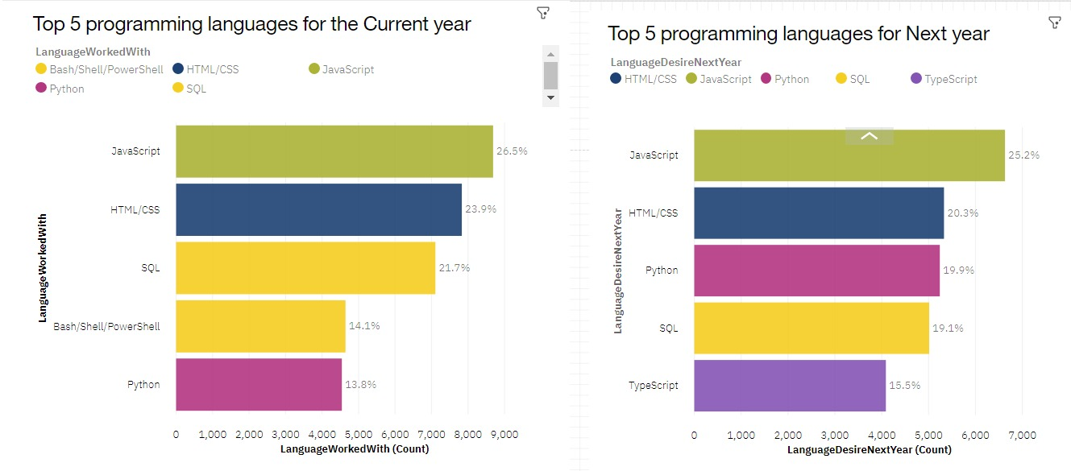
PROGRAMMING LANGUAGE TRENDS
Current year
Next year

Slide 8
PROGRAMMING LANGUAGE
Observations
Currently, the most widely used programming languages are JavaScript, HTML/CSS, SQL, Shell languages, and Python. Looking ahead to next year and beyond, JavaScript, HTML/CSS, Python, SQL, and TypeScript are expected to dominate. Python, in particular, is projected to surpass SQL in demand next year.
Suggestions
JavaScript and HTML are essential for web development, making web development one of the most in-demand tech skills, especially with the rising popularity of TypeScript. Python is increasingly sought after due to the growing demand for AI and ML expertise. SQL remains the most relevant language for data professionals, making it crucial for aspiring data analysts, scientists, and business analysts to master SQL skills.

Slide 9
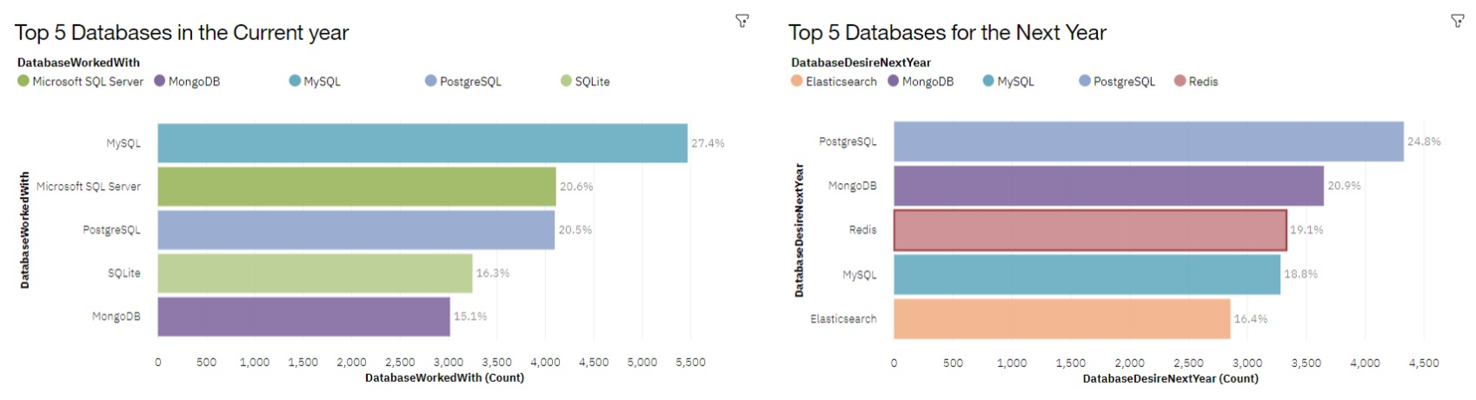
DATABASE TRENDS
Current year
Next year

Slide 10
DATABASE TRENDS
Observations
Currently, the top five most used databases are MySQL, Microsoft SQL Server, PostgreSQL, SQLite, and MongoDB. However, PostgreSQL, MongoDB, Redis, MySQL, and Elasticsense are projected to become more popular in the future. Redis and Elasticsense, being relatively new tools, are set to gain more traction in the IT space.
Consequences
SQL remains a top tool for data specialists. Companies continue to favor open-source databases. Oracle SQL, however, was not among the top five and is gradually losing relevance over time.

Slide 11
Dashboard code link in Juypter Notebook
Data_Analyst_Course/Dashbord code.ipynb at main · MPS90MP/Data_Analyst_Course

Slide 12
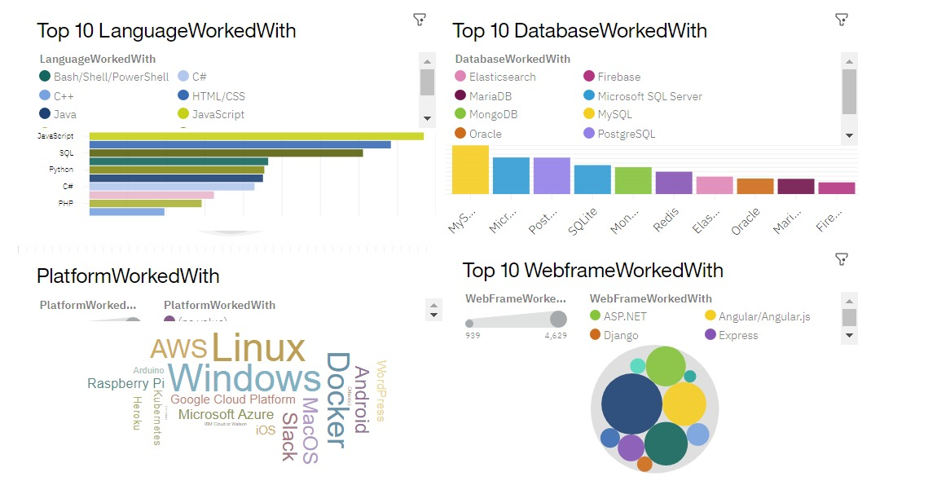
DASHBOARD TAB 1

Slide 13
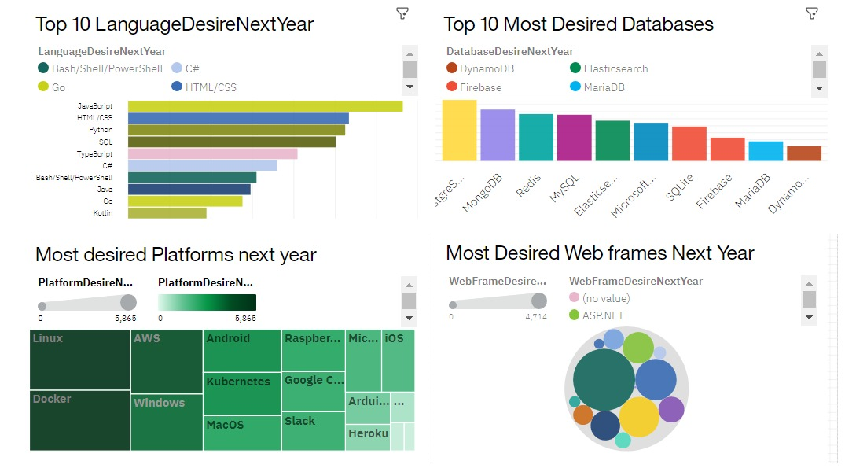
DASHBOARD TAB 2

Slide 14
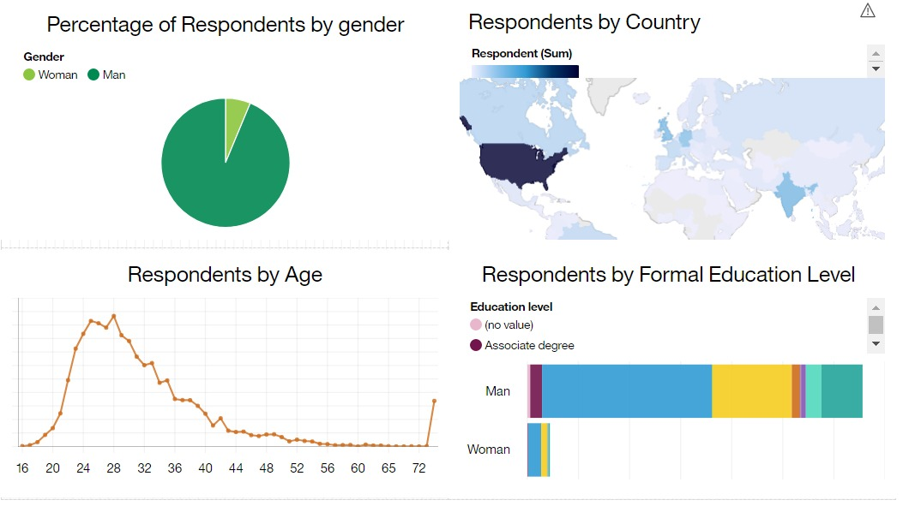
DASHBOARD TAB 3

Slide 15
Outline
DISCUSSION
Upskilling in the tech sector.
Closing the gender gap in technology.
Is a master's or doctorate degree necessary?
Rising demand for mobile development with Kotlin.
Expanding tech education and access in less developed regions (South East Asia, South America, Africa, parts of Europe).
Future relevance of Oracle SQL.

Slide 16
Outline
CONCLUSION
Most IT professionals have a bachelor's degree.
Web development languages are currently the most popular and in-demand tools in IT.
The tech sector is predominantly composed of individuals under 40.
Many respondents aim to learn PostgreSQL and React JS next year.
Data professionals should master NoSQL alongside SQL databases.
Web development remains a lucrative skill.
Less developed countries need greater access to tech training and education.

Slide 17
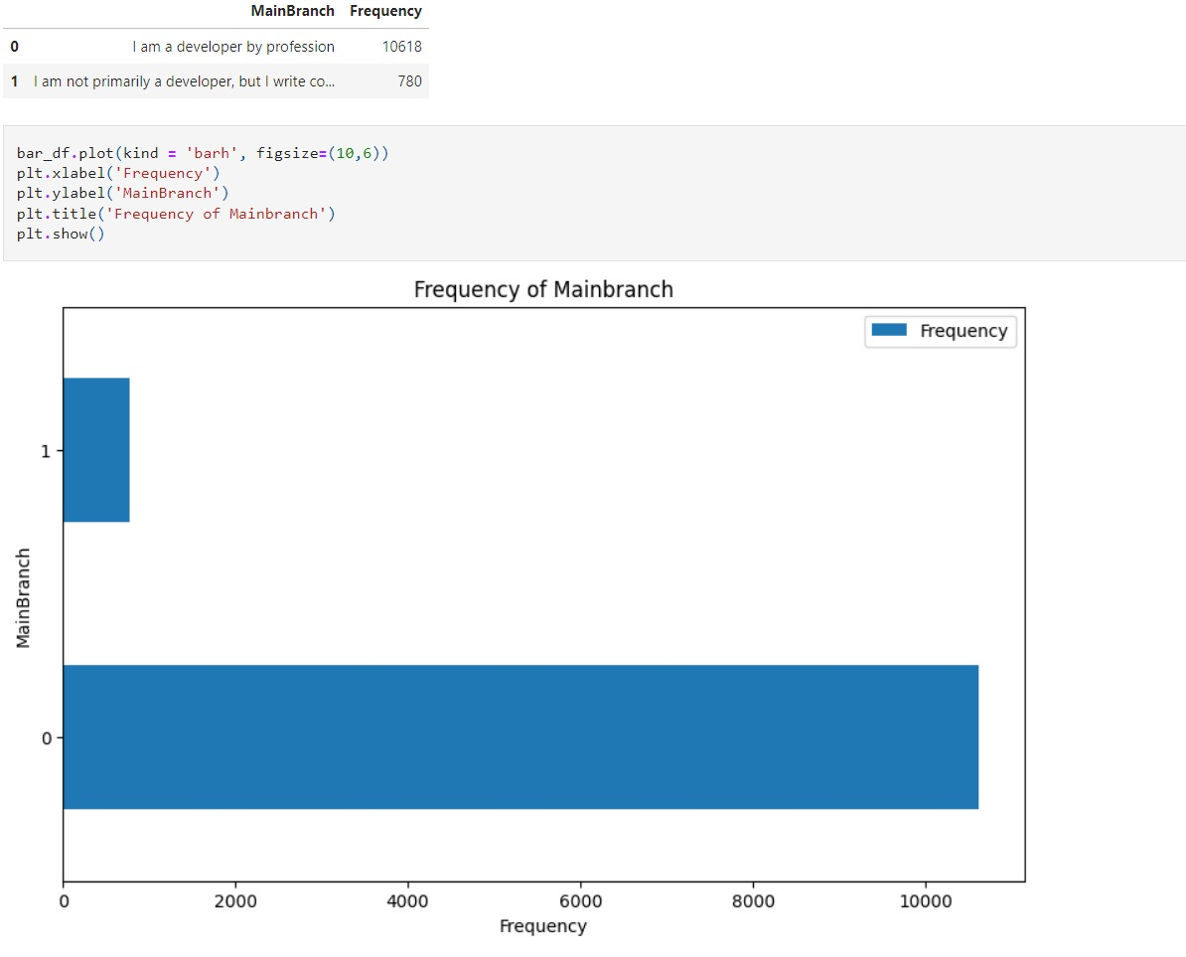
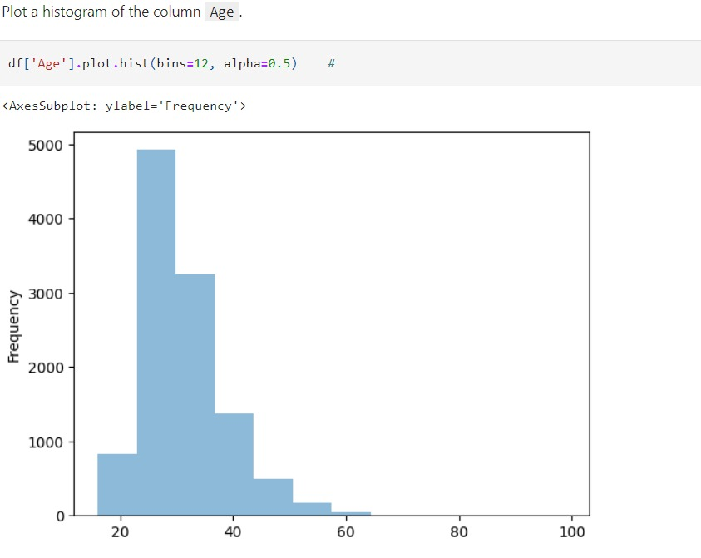
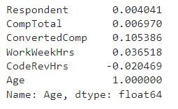
APPENDIX

Slide 18
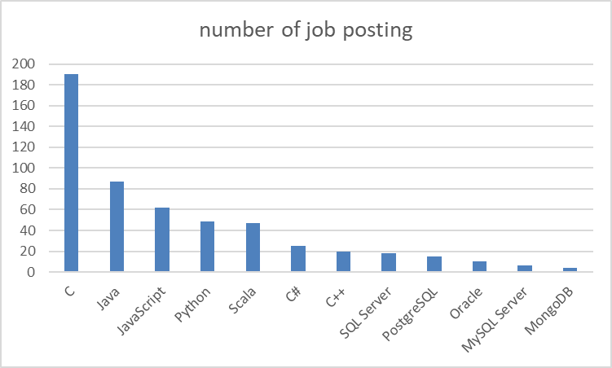
JOB POSTINGS
Bar chart presenting the job posting data collected using Github Job API.

Slide 19
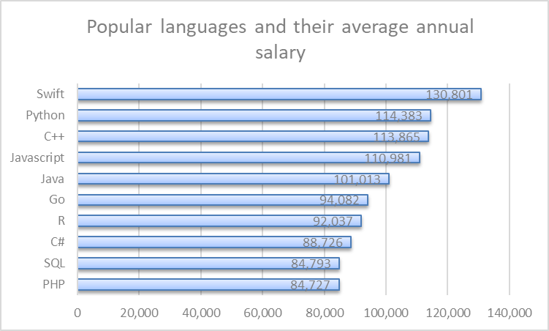
POPULAR LANGUAGES
Bar chart displaying popular languages and their average annual salary. The data was collected through web scraping the Github jobs data and saved in a csv file.

